Slide 1
LoRa

Slide 2
01
LoRa Technology
LoRa Feature
LoRa Radio Freq
LoRaWan
02
LoRa Applications
03
LoRa Module Hands-on
H/W Introduce
AT Commands
Hands-on
04
LoRa Application Hands-on
Setup Development environment
Libraries
UnConfirmed Up Demo
Confirmed Up Hand-on
Downlink Demo
Appendix
LoRa Gateway

Slide 3
LoRa Technology
LoRa Feature
LoRa Radio Freq
LoRaWan

Slide 4
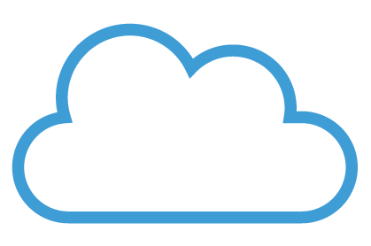
LoRa Feature

Slide 5
What is LoRa?
LoRa is a Low-Power Wireless Wide Area Network (LPWAN) that provides very wide coverage with coverage over 10 km and a communication speed of up to several kilobits per second (kbps).
LPWAN can have up to many years of battery life.
LPWAN technology, is mainly used as a dedicated network technology for low power internet of things (IoT). (For example, water, gas, electric meter monitoring)
Types of LPWAN include LoRa, Sigfox, LTE-MTC, and NB-IoT.
LoRa and Sigfox are ISM license-free band. And LTE Machine-Type communications (LTE-MTC) and Narrowband Internet of Things(NB-IoT) technologies that use mobile licensed bands.

Slide 6
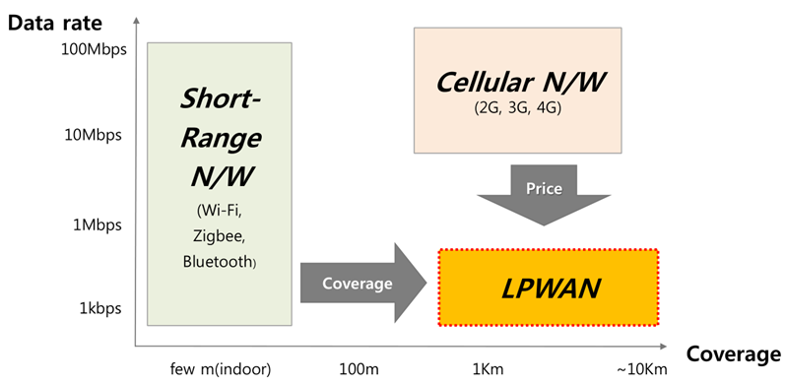
Why LoRa?
Wide Coverage
Low chip price
Low power

Slide 7
LoRa technology
LoRa is based on Chirp Spread Spectrum. Chirp signal is the technology used for existing radar and distance / position positioning, and is the core of LoRa technology that ables long range and low power.
It is an advantage that frequency / time error and synchronization can be adjusted quickly.
High reliability
Multipath resistant
Low power consumption
Low latency

Slide 8
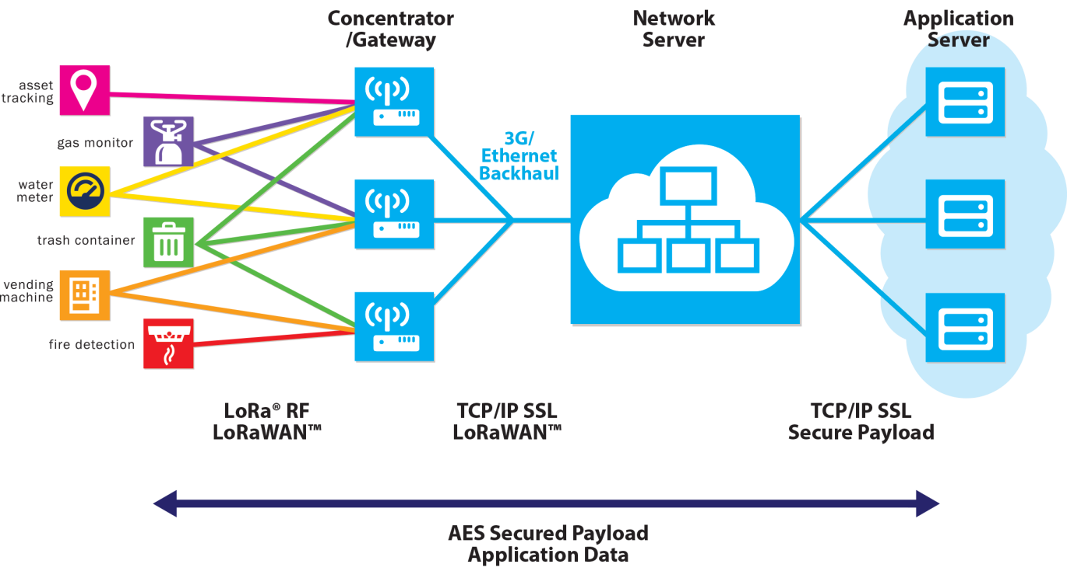
LoRa network structure
The LoRa network structure consists of LoRa device, LoRa gateway, a network server, and an App Server.

Slide 9
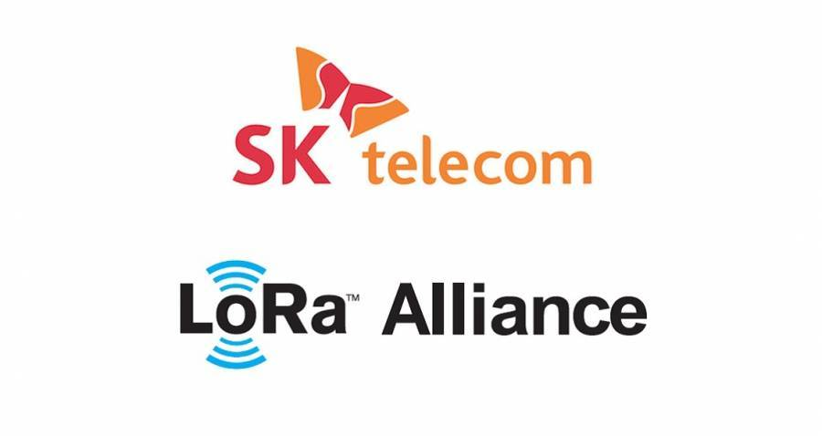
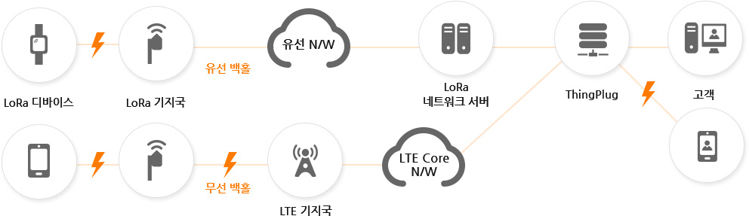
LoRa network structure (Korea SK Telecom)

Slide 10
LoRa Radio Freq

Slide 11
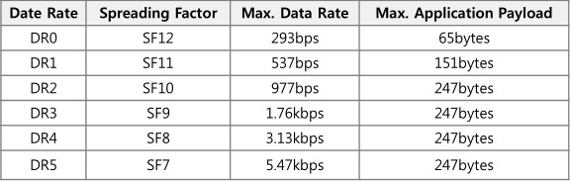
LoRa Data Rate
There are 6 data rates from DR0 to DR5, and LoRa device operates with one of 6 DRs.
Spreading Factor, Maximum Data Rate, and Maximum Application Payload Size for each DR are as follows.

Slide 12
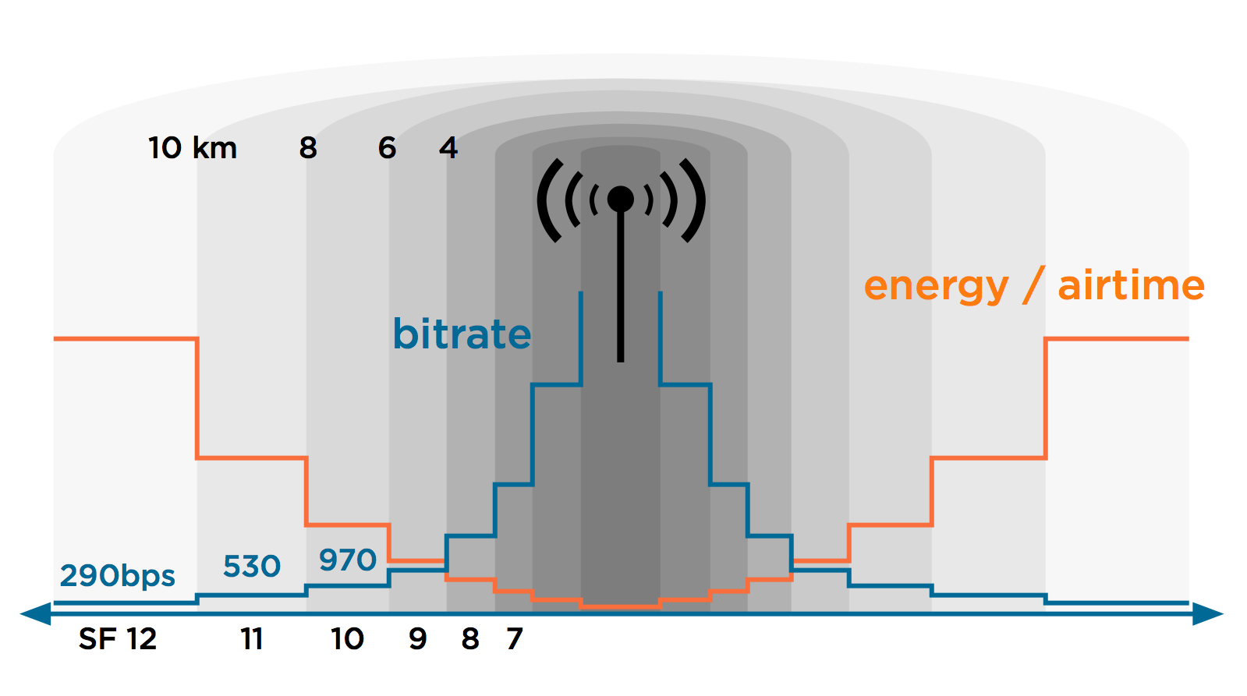
LoRa ADR (Adaptive data rate scheme)
The lower DataRate, the longer distance communication is possible, but the longer the channel occupation time is.
Therefore, the LoRa Network Server reduces the speed of the devices that are far away by the receiving sensitivity, and increases the devices that are near the distance.

Slide 13
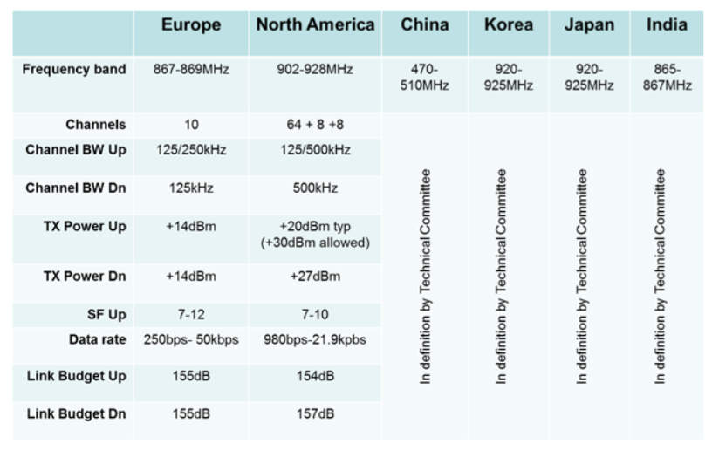
LoRa ISM Band
The LoRa ISM Band differs from country to country and must comply with the country's frequency law.

Slide 14
LoRa ISM Band - India
Channel | Frequency | Modulration /BW
0 | 865.400 Mhz | MultiSF / 125 Khz
1 | 865.600 Mhz | MultiSF / 125 Khz
2 | 865.800 Mhz | MultiSF / 125 Khz
3 | 866.000 Mhz | MultiSF / 125 Khz
4 | 866.200 Mhz | MultiSF / 125 Khz
5 | 866.400 Mhz | MultiSF / 125 Khz
6 | 866.600 Mhz | MultiSF / 125 Khz
7 | 866.800 Mhz | MultiSF / 125 Khz
Rx2 | 865.200 Mhz | SF12 / 125Khz

Slide 15
LoRa ISM Band – EU868
Channel | Frequency | Modulration /BW
0 | 868.100 Mhz | MultiSF / 125 Khz
1 | 868.300 Mhz | MultiSF / 125 Khz
2 | 868.500 Mhz | MultiSF / 125 Khz
3 | 868.700 Mhz | MultiSF / 125 Khz
4 | 868.900 Mhz | MultiSF / 125 Khz
5 | 869.100 Mhz | MultiSF / 125 Khz
… | … | …
15 | 871.100 Mhz | MultiSF / 125 Khz
Rx2 | 869.525 Mhz | SF9 / 125Khz

Slide 16
LoRa ISM Band – KR920
Channel | Frequency | Modulration /BW
0 | 920.900Mhz | MultiSF / 125 Khz
1 | 921.100Mhz | MultiSF / 125 Khz
2 | 921.300 Mhz | MultiSF / 125 Khz
3 | 921.500 Mhz | MultiSF / 125 Khz
4 | 921.700 Mhz | MultiSF / 125 Khz
5 | 921.900 Mhz | MultiSF / 125 Khz
… | … | …
12 | 923.300 Mhz | MultiSF / 125 Khz
Rx2 | 921.900 Mhz | SF12 / 125Khz

Slide 17
LoRaWan

Slide 18
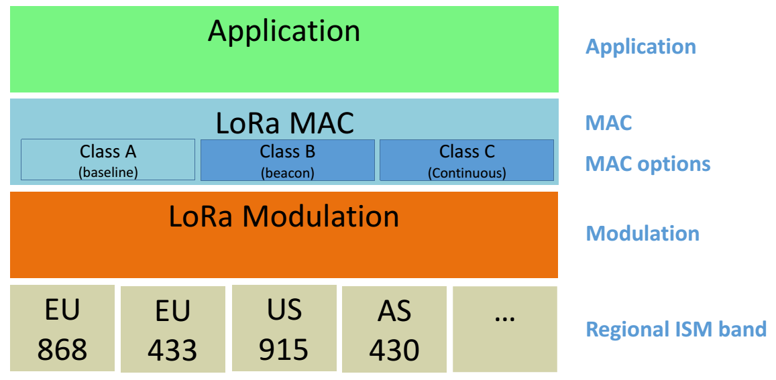
LoRaWan Structure

Slide 19
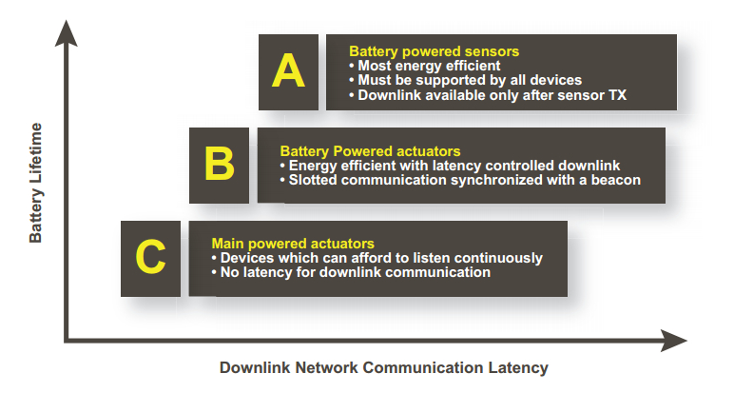
LoRa Device Classes

Slide 20
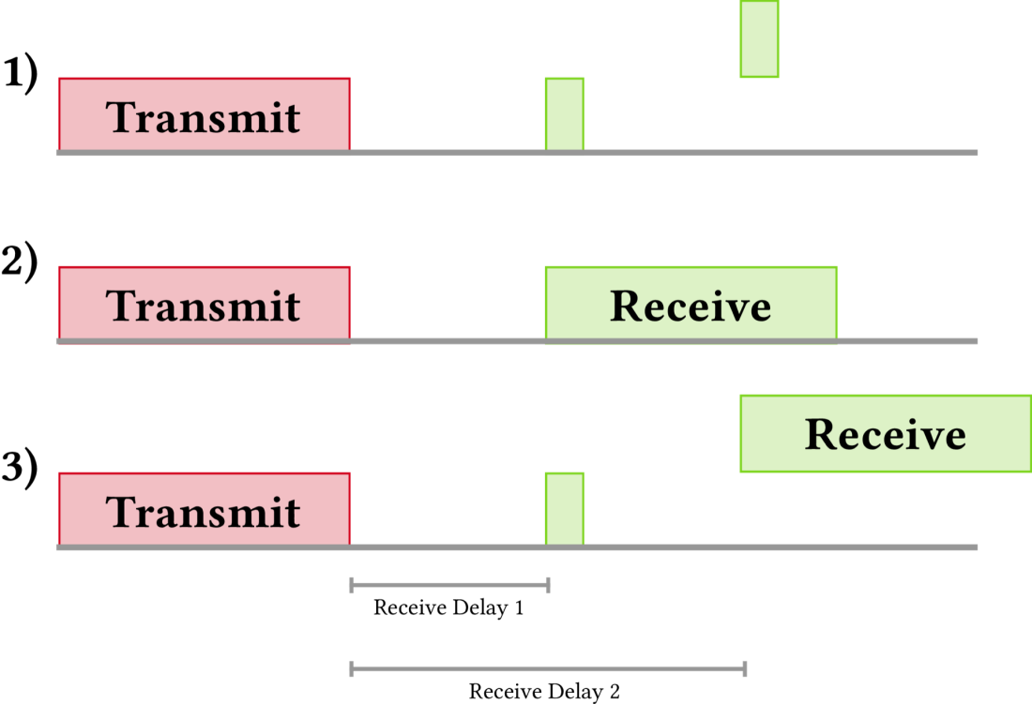
LoRa Device Class A

Slide 21
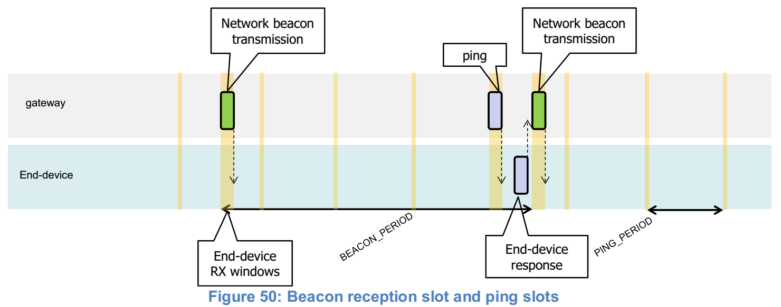
LoRa Device Class B

Slide 22
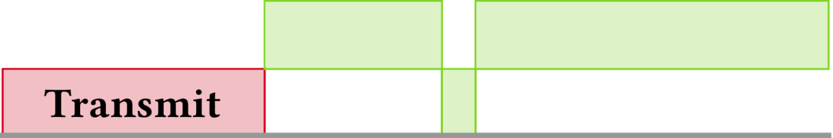
LoRa Device Class C
Rx2
Rx2
Rx1

Slide 23
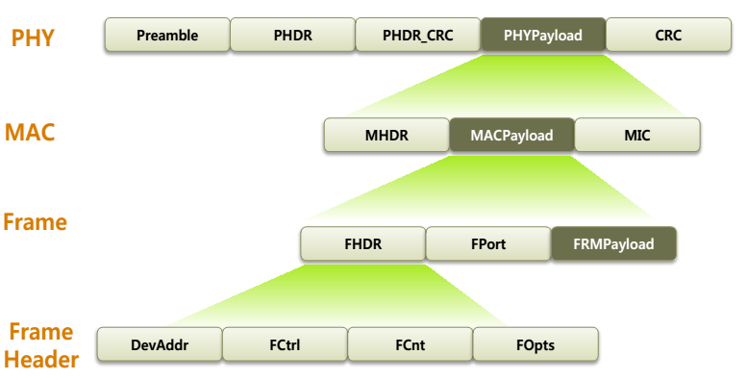
LoRa MAC Layer
MAC Payload : The length is variable and consists of FHDR, Fport, and FRMPayload.
MIC : Message Integrity Check(4bytes), Used to check the integrity of MAC messages
FHDR : Frame Header(7~22bytes), Variable length includes DevAddr, FCtrl, FCnt, Fopts
DevAddr : Device Address(4bytes), When the device joins the system, to be allocated.
FCtrl : Frame Control(1bytes), Field that defines the characteristics of the frame.

Slide 24
LoRa Service ID System
LoRa service utilizes DevEUI and AppEUI to distinguish between devices and services. DevEUI is a standard established by the IEEE, Global Unique.
ID | Length | Form | Release by | Comment
DevEUI | 64bit | 16bytes hex string | IEEE | IEEE MAC Address
AppEUI | 64bit | 16bytes hex string | LoRa network licensee | Service separator
AppKEY | 128bit | 32bytes hex string | LoRa network licensee | Security Key

Slide 25
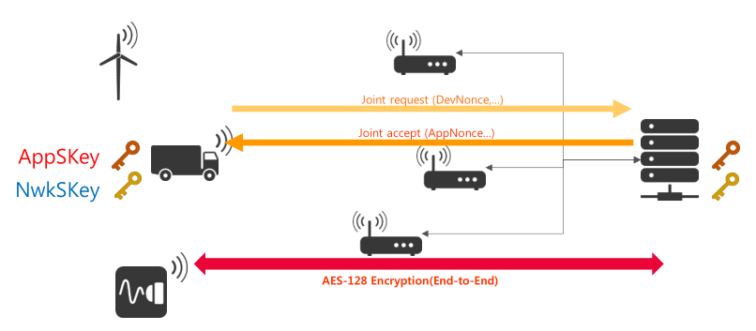
LoRa Security Over-The-Air-Activation (OTAA)
AppNonce(3) |
NetID(3) |
DevAddr(4) |
DLSetting(1) |
RXDelay(1) |
CFList(16, op)
AppEUI(8) |
DevEUI(8) |
DevNonce(2)

Slide 26
LoRa Security Over-The-Air-Activation (OTAA)
LoRa Device
Join Request
LoRa Server
DevEUI AppEUI AppKey
DevEUI AppEUI AppKey
Join Accept

Slide 27
LoRa Security Activation by Personalization (ABP)
Using ABP join mode requires the user to define the following values and input them into the device
DevADDR, APPSKEY, NWSKEY

Slide 28
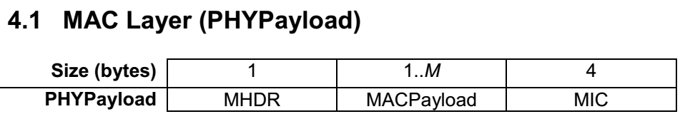
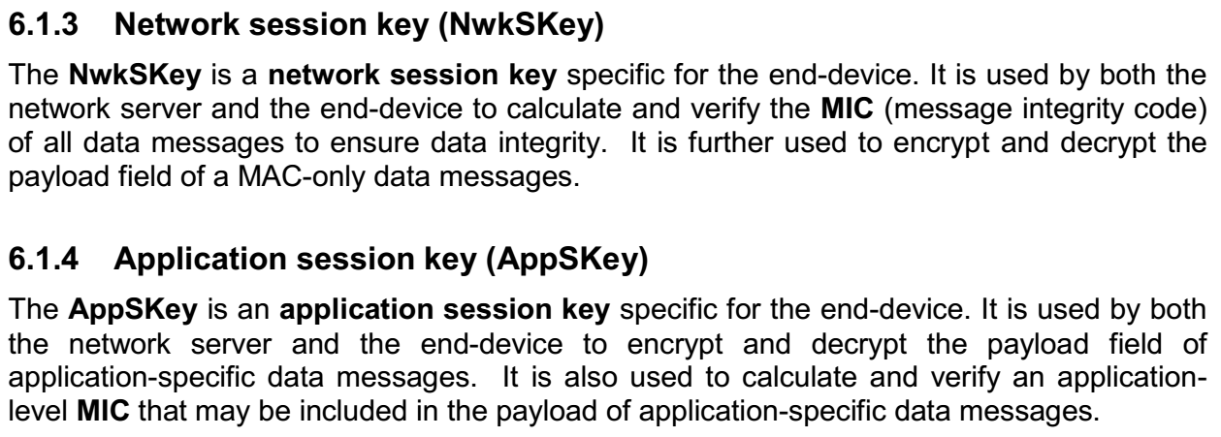
LoRa Security

Slide 29
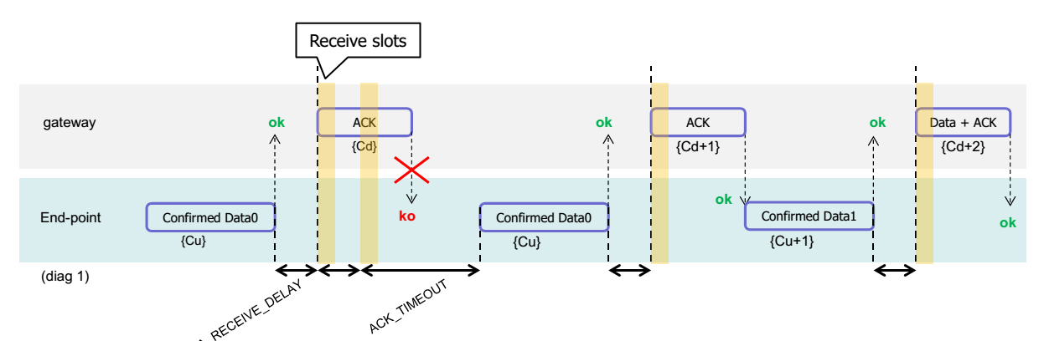
LoRa Data Uplink - Confirmed
Confirmed Uplink replies ACK from LoRa server in Rx slot after Uplink.
If ACK is not received, it retransmits the number of times set up (up to 8 times).

Slide 30
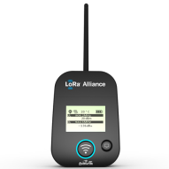
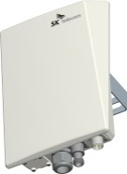

LoRa Data Uplink - Confirmed
1st Confirmed Up
Ack Rx
2nd Confirmed Up
Ack Rx
.
.
.
The device transmits the number of retrans times until it receives an Ack.

Slide 31
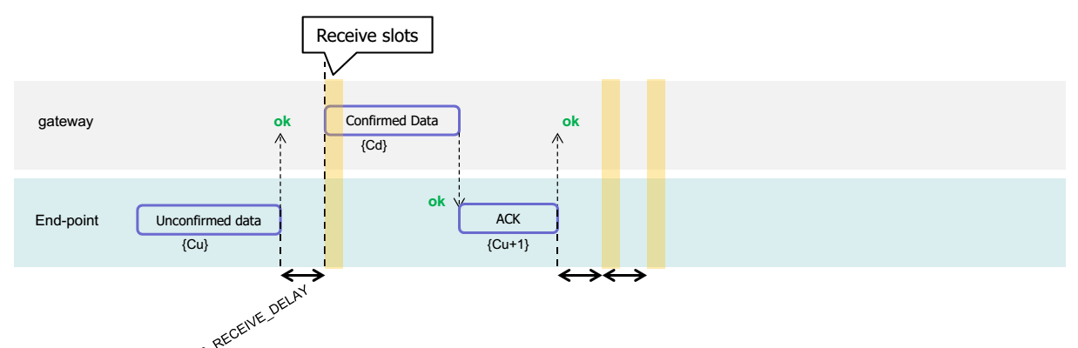
LoRa Data Uplink - Unconfirmed
Unconfirmed Uplink does not receive ACK.
The figure above shows the Unconfirmed Uplink, receiving the Confirmed Downlink from the server, and sending the ACK again.

Slide 32
LoRa Data Uplink - Unconfirmed
1st UnConfirmed Up
2nd UnConfirmed Up
3rd UnConfirmed Up
4th UnConfirmed Up
Transmission until the number of Retrans
or Downlink Data
.
.
.

Slide 33
LoRa ApPLICATIONS

Slide 34
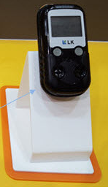
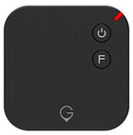
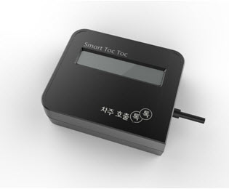
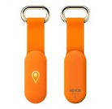
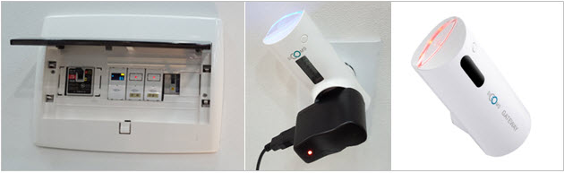
LoRa Application
Gas AMI
Tracker
Shock detector
Monitoring

Slide 35
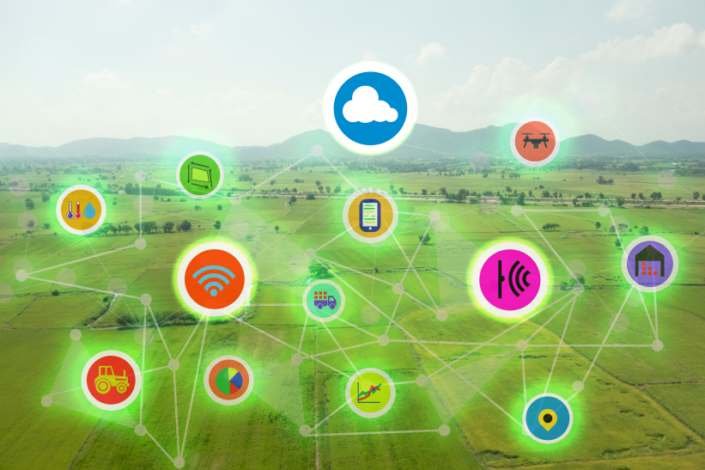
LoRa Application
Smart Farm

Slide 36
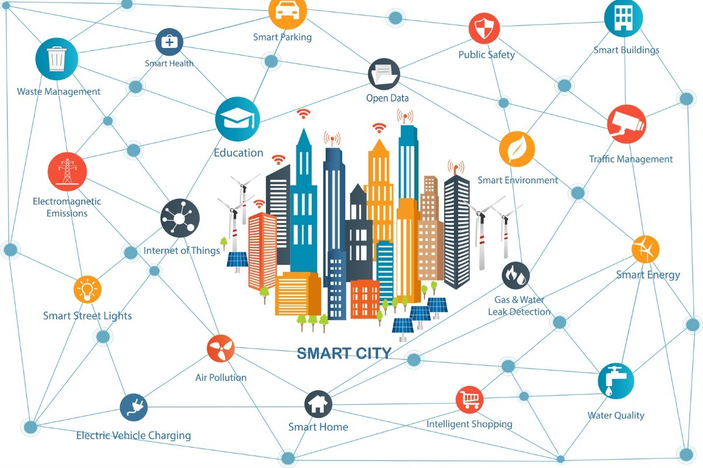
LoRa Application

Slide 37
LoRa Module hand-on
H/W Introduce
AT Commands
Hands-on

Slide 38
H/W Introduce

Slide 39
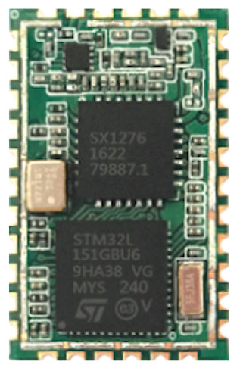
WIZLoRa100
Module integrates Semtech SX1276 and stm32L.
Offer user an serials At commands with UART Interface
Long Range LoraWAN operating in the 868 MHz or 915 MHz frequency bands
Small size and low power
TX Power: adjustable up to +14 dBm high efficiency PA, max PA boost up to 20dbm
Up to 15 km coverage at suburban and up to 5 km coverage at urban area

Slide 40
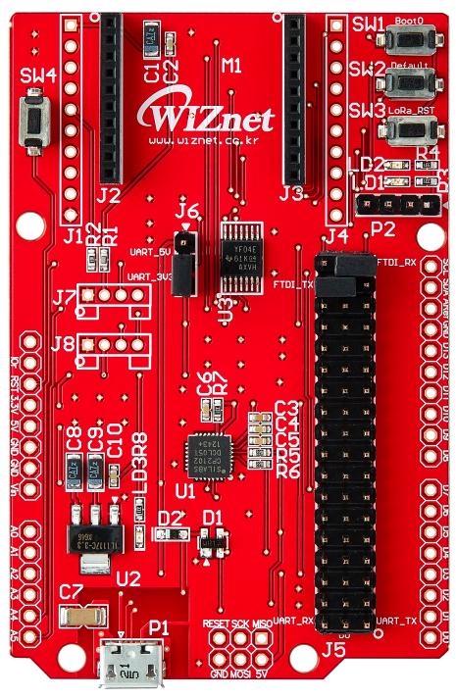
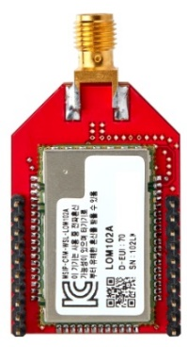
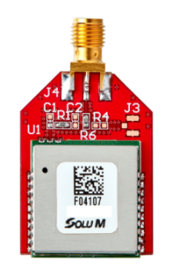
LoRa_EVB
SMA, U.FL Connector
XBEE compatible
BootMode Button
User Button
Module Reset
Arduino Reset
LoRa Module SWD
GND/SWCLK/SWDIO/VCC
UART PIN
Level Shift
Grove Sensor
Compatable
LoRa Module UART Tx/Rx Select
Pin header
UART to USB Chip
Arduino H/W
Compatible
Micro USB Socket

Slide 41


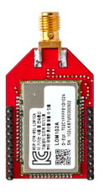
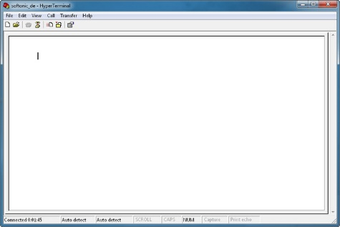
Module Hands-on
Serial Terminal
Baud Rate | 115,200bps
Data bit | 8bit
Stop bit | 1bit
Parity bit | None
Setup CP2102 USB Driver
Tools -> CP210x_Windows_Drivers.zip

Slide 42
AT Commands
Procedure | Command to send | Parameter
Print AT Commands list | AT+MHELP | -
Set APPKEY (Only OTAA) | AT+LAK=… | 16 Bytes AppKey
Set NWSKEY (Only ABP) | AT+LNWSK=… | 32 Bytes NWSKEY
Set APPSKEY (Only ABP) | AT+LAPSK=… | 32 Bytes APPSKEY
Set APPEUI (Only OTAA) | AT+LAEUI=… | 8 Bytes AppEUI
Set DEVEUI (Only OTAA) | AT+LDEUI=… | 8 Bytes DevEUI
Set Confirmed Retrans Number | AT+LRCNT=5 | 1~8 Number
Set Unconfirmed Repit Number | AT+LUNREP=3 | 1~15 Number
Set Confirmed / Unconfirmed | AT+LCFM=1 | 0 = Unconfimred 1 = Confimred
Data uplink | AT+LSEND=1,1234 | Port number, Send data
Set Class | AT+LCLS=C | A = Class A B = Class B (Not Support) C = Class C
Set DataRate | AT+LDR=5 | 0~5 DataRate
Set ADR | AT+LADR=0 | 0 = ADR off 1 = ADR on
Join mode | AT+LJOIN=OTAA | OTAA = OTAA mode ABP = ABP mode
Module reset | AT+LRESET | -

Slide 43
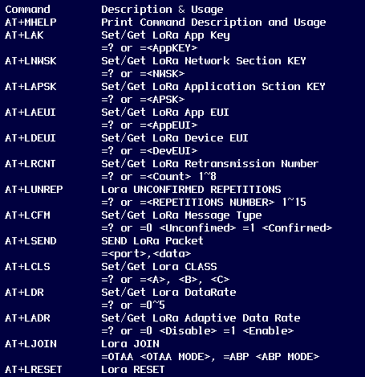
AT+MHELP

Slide 44
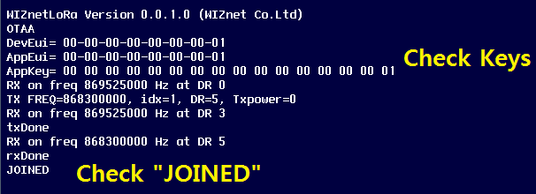
LoRa Join procedure
Set the DevEui, AppEUI, and Appkey numbers on the board.
AT Commands | Comment
AT+LDEUI=000000000000000x | x : Kit Number
AT+LAEUI=0000000000000001 | APPEUI Fix
AT+LAK=0000000000000000000000000000000x | x : Kit Number
AT+LRESET
Check message

Slide 45
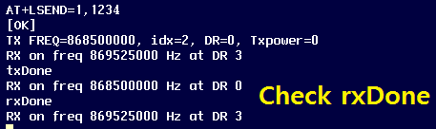
LoRa_Data Send
Send Data
AT Commands | Comment
AT+LSEND=1,1234

Slide 46
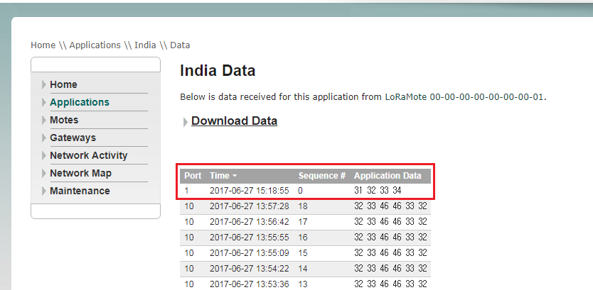
LoRa_Data Send
Server Log

Slide 47
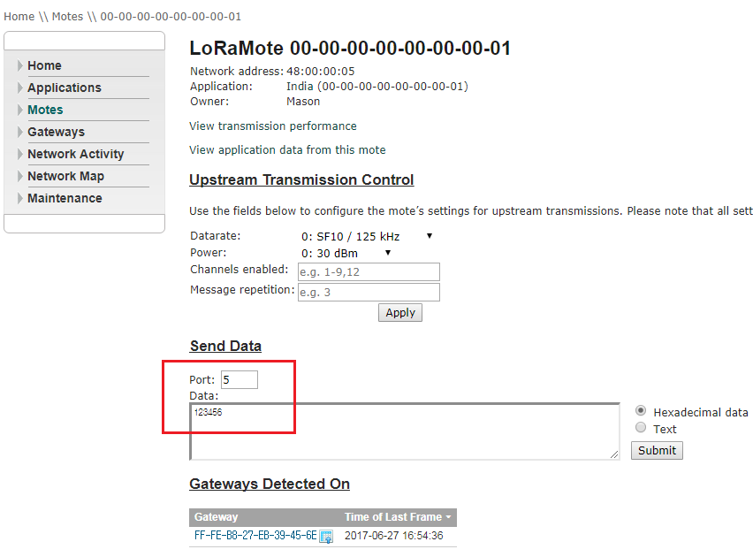
LoRa_Data Receive
Server Log

Slide 48
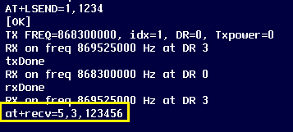
LoRa_Receive
Device Log
Message | Comment
at+recv=5,3,123456 | 5=Port Num 3=Data Length 123456=Data

Slide 49
LoRa Application hand-on
Setup Development environment
Libraries
UnConfirmed Up Demo
Confirmed Up Hand-on
Downlink Demo

Slide 50
Setup Development
environment

Slide 51
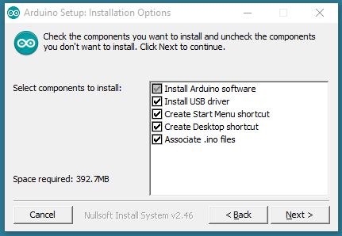
Arduino Setup
Setup Arduino Sketch https://www.arduino.cc/download_handler.php
There is setup file in tools folder.

Slide 52
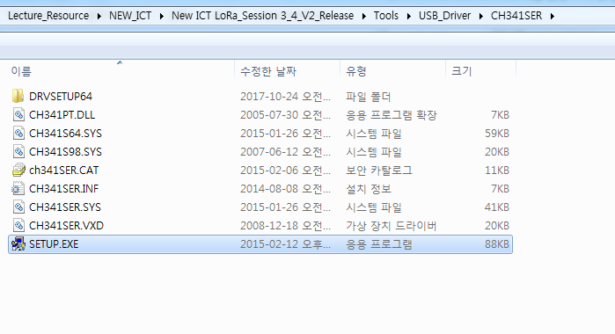
Arduino USB Driver
USB Driver Setup
Tools -> USB_Driver -> CH341SER -> SETUP.EXE

Slide 53
Arduino Libraries
Libraries folder copy.
Paste to my documents -> arduino -> libraries.

Slide 54
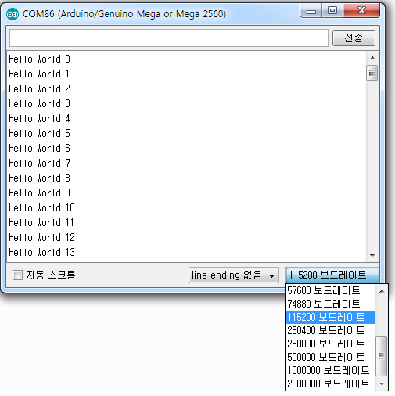
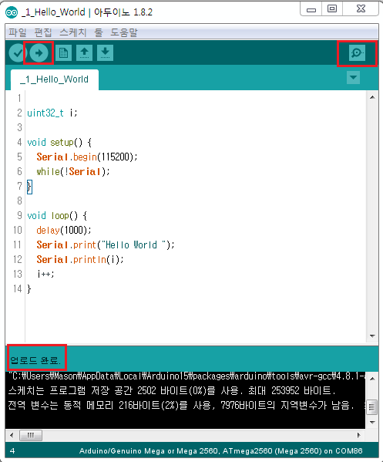
Arduino Hello World
Open Firmware 1_Hello_World
Click icon to upload, Check upload complete message
Click the icon to open the serial monitor, Setting baudrate 115200
Check message output.

Slide 55
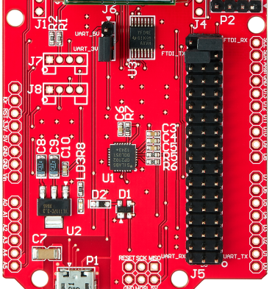
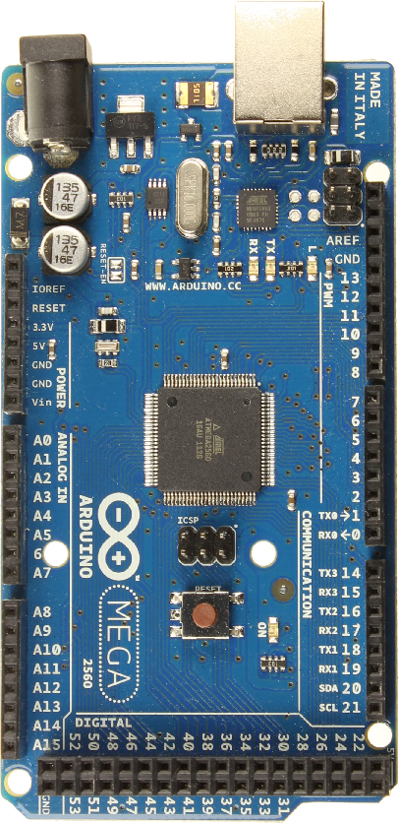
H/W Setting
1. Move Jumper Cap to J6 UART_5V
2. Arduino Board and LoRa EVB Stacking
3. Remove 2 Jumper Caps from J5 Pinheader
4. Using the enclosed pinheader and wire Connect UART_RX <-> TX3 14 Connect UART_TX <-> RX3 15
5. Easy Shield Stacking
Move UART_5V
Connect
Jumper Cable

Slide 56
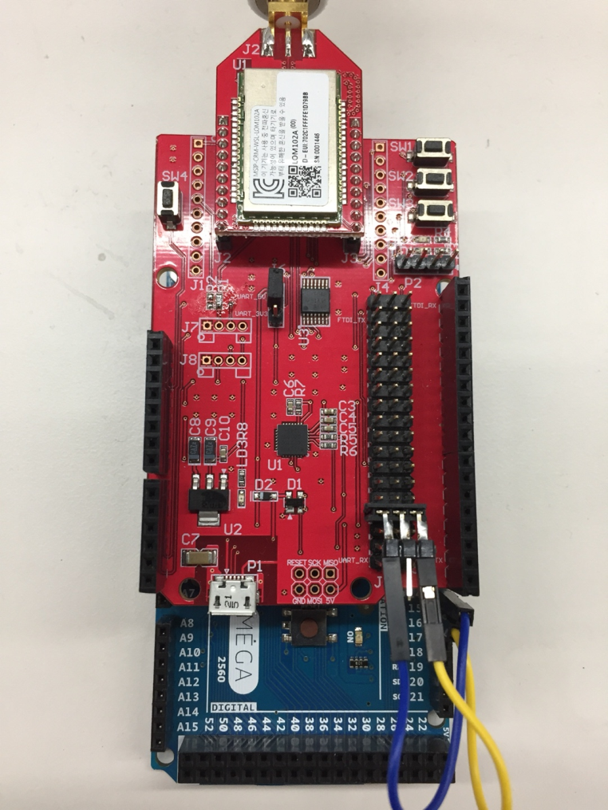
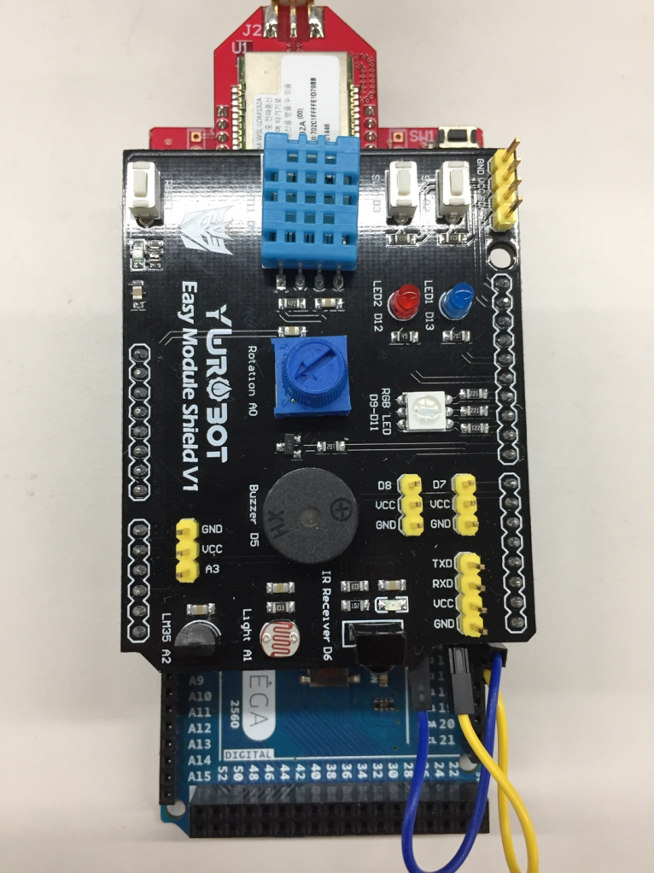
H/W Setting
LoRa EVB + Arduino
Easy Shield

Slide 57
Libraries

Slide 58
Library
DHT11 library
Function prototype | Comment | Example
int read( float& humidity, float& temperature); | Read humidity, temperature | dht11.read(humi, temp)
Timer-master library
Function prototype | Comment | Example
int8_t after(unsigned long duration, void (*callback)(void)); | Run callback after duration. | send_t.after(10, send_timer_handler);
int8_t every(unsigned long period, void (*callback)(void)); | Always run callback periodically. | send_t.every(10, send_timer_handler);
void stop(int8_t id); | Stop timer | timeout_t.stop(timeout_timer_id);
void update(void); | Update timer | send_t.update();

Slide 59
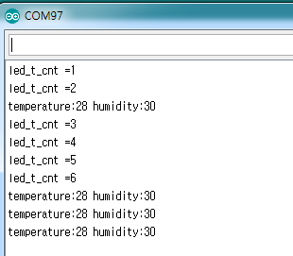
DHT11 Timer Library Test
Open DHT11_Timer_lib_test.ino. Complie and Upload

Slide 60
LoRa Library
Function prototype | Comment | Example
void LoRaClass::init(Stream *LoRaSerial) | LoRa UART assign | LoRa.init(&Serial3);
int LoRaClass::available() | Check LoRa UART available | LoRa.available();
int LoRaClass::read() | Read LoRa UART | LoRa.read();
int LoRaClass::begin() | LoRa Reset & Check JOINED | LoRa.begin();
String LoRaClass::classType() | Get Class | LoRa.LoRaClass();
int LoRaClass::classType(int cls) | Set Class | LoRa.LoRaClass('C');
int LoRaClass::ADR(int adr) | Set ADR | LoRa.ADR(1);
String LoRaClass::DR() | Get DR | LoRa.DR();
int LoRaClass::DR(int dr) | Set DR | LoRa.DR(5);
String LoRaClass::devEUI() | Get DevEUI | LoRa.devEUI();
String LoRaClass::appEUI() | Get AppEUI | LoRa.appEUI();
int LoRaClass::retxConf(int count) | Set Confirmed ReTx | LoRa.retxConf(5);
int LoRaClass::Confirmed(int confirmed) | Set Confirmed | LoRa.Confirmed(1);
int LoRaClass::send(const char *data, uint16_t port) | LoRa Data | LoRa.send("1234", 5);

Slide 61
Unconfirmed Up Demo

Slide 62
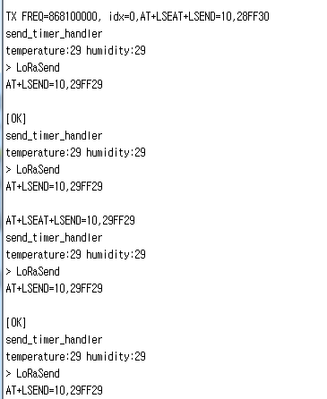
Unconfirmed Uplink
Open _3_Unconfirmed_Uplink project. Complie and Upload
Unconfimred uplink temperature & humidity
Set Class C
ADR On
DataRate 5
Set Unconfimred
Repit count 3
Period 30 Sec

Slide 63
Confirmed Up
Hands-on

Slide 64

Confirmed Up
Count 10 over
ACK Non-receipt
Enter Timout Handler
Increase Timeout CNT
ACK receipt
Count under 10

Slide 65
Downlink Demo

Slide 66

Downlink
Open _5_Downlink project. Complie and Upload
Downlink Data 0x01

Slide 67




Downlink

Slide 68
Appendix
LoRa Gateway

Slide 69

LoRa Gateway
RisingHF RHF0M301
http://www.risinghf.com/product/risinghf-iot-dicovery/?lang=en

Slide 70

Q&A 감사합니다

